Slide 1


CAPSTONE
PROJECT
DS106
Presented by: Filbert & Darius
Github Profile:
Darius: https://github.com/spreadjam
Filbert: https://github.com/adonis941
PAGE 01

Slide 2

AGENDA
Overview
Problem Statement
Workflow to tackling problem
Data Pre-processing
Exploratory Data Analysis
Machine Learning Models
Linear Regression Model
Lasso Regression Model
Ridge Regression Model
ElasticNet Model
Random Forest Model
Support Vector Regressor Model
Gradient Boosting
XGBoost
Models Comparison
HDB Price Predictor
Challenges
Conclusion of Project
PAGE 02

Slide 3

OVERVIEW
We are reaching the stage in our lives where a number of our peers are starting to purchase HDB flats of their own. With the recent news about HDB flats being transacted at record high prices, there have been both hopes and concerns regarding future HDB prices; hopes for those hoping to sell their flats at a profit and concerns for those looking to start buying their own flat.
This project aims to provide some guidance on future resale HDB prices, including current brand new BTO flats. This guide will be aimed at new BTO flat owners looking to offload their flat after the MOP of 5 years is up and for potential owners looking for a flat to own to last through their lifetime.
PAGE 03

Slide 4
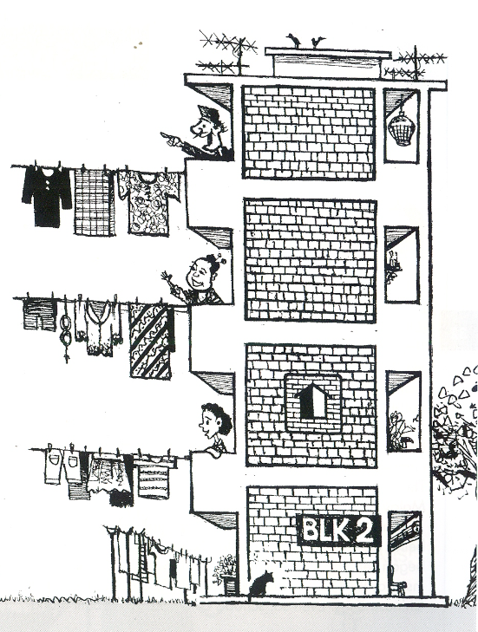
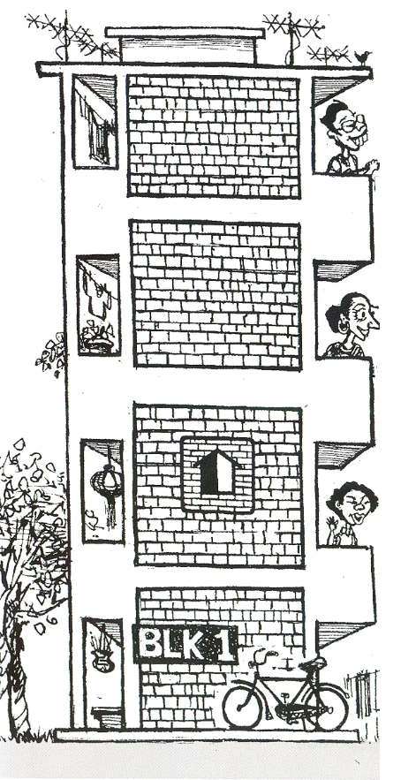
PROBLEM STATEMENT
Provide assistance for anyone who wishes to find out the price of resale flat with their desired set of requirements in 5 years time.
Build a HDB price predictor tool to help new BTO owners gauge their flat's resale value after 5 years MOP
PAGE 04

Slide 5
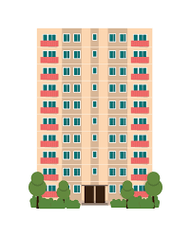






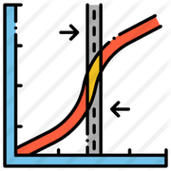
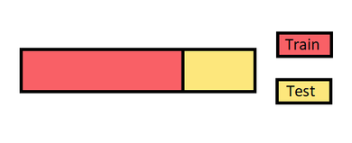


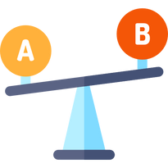
WORKFLOW TO TACKLING PROBLEM
Data
Data Pre-processing
Exploratory Data Analysis
Categorical Encoding
Tuning & Boosting of Models
Evaluation the models
Models Training & Testing
Train Test Split
Comparing the Models
Choosing the best model for the HDB Price Predictor
Conclusion
PAGE 05

Slide 6
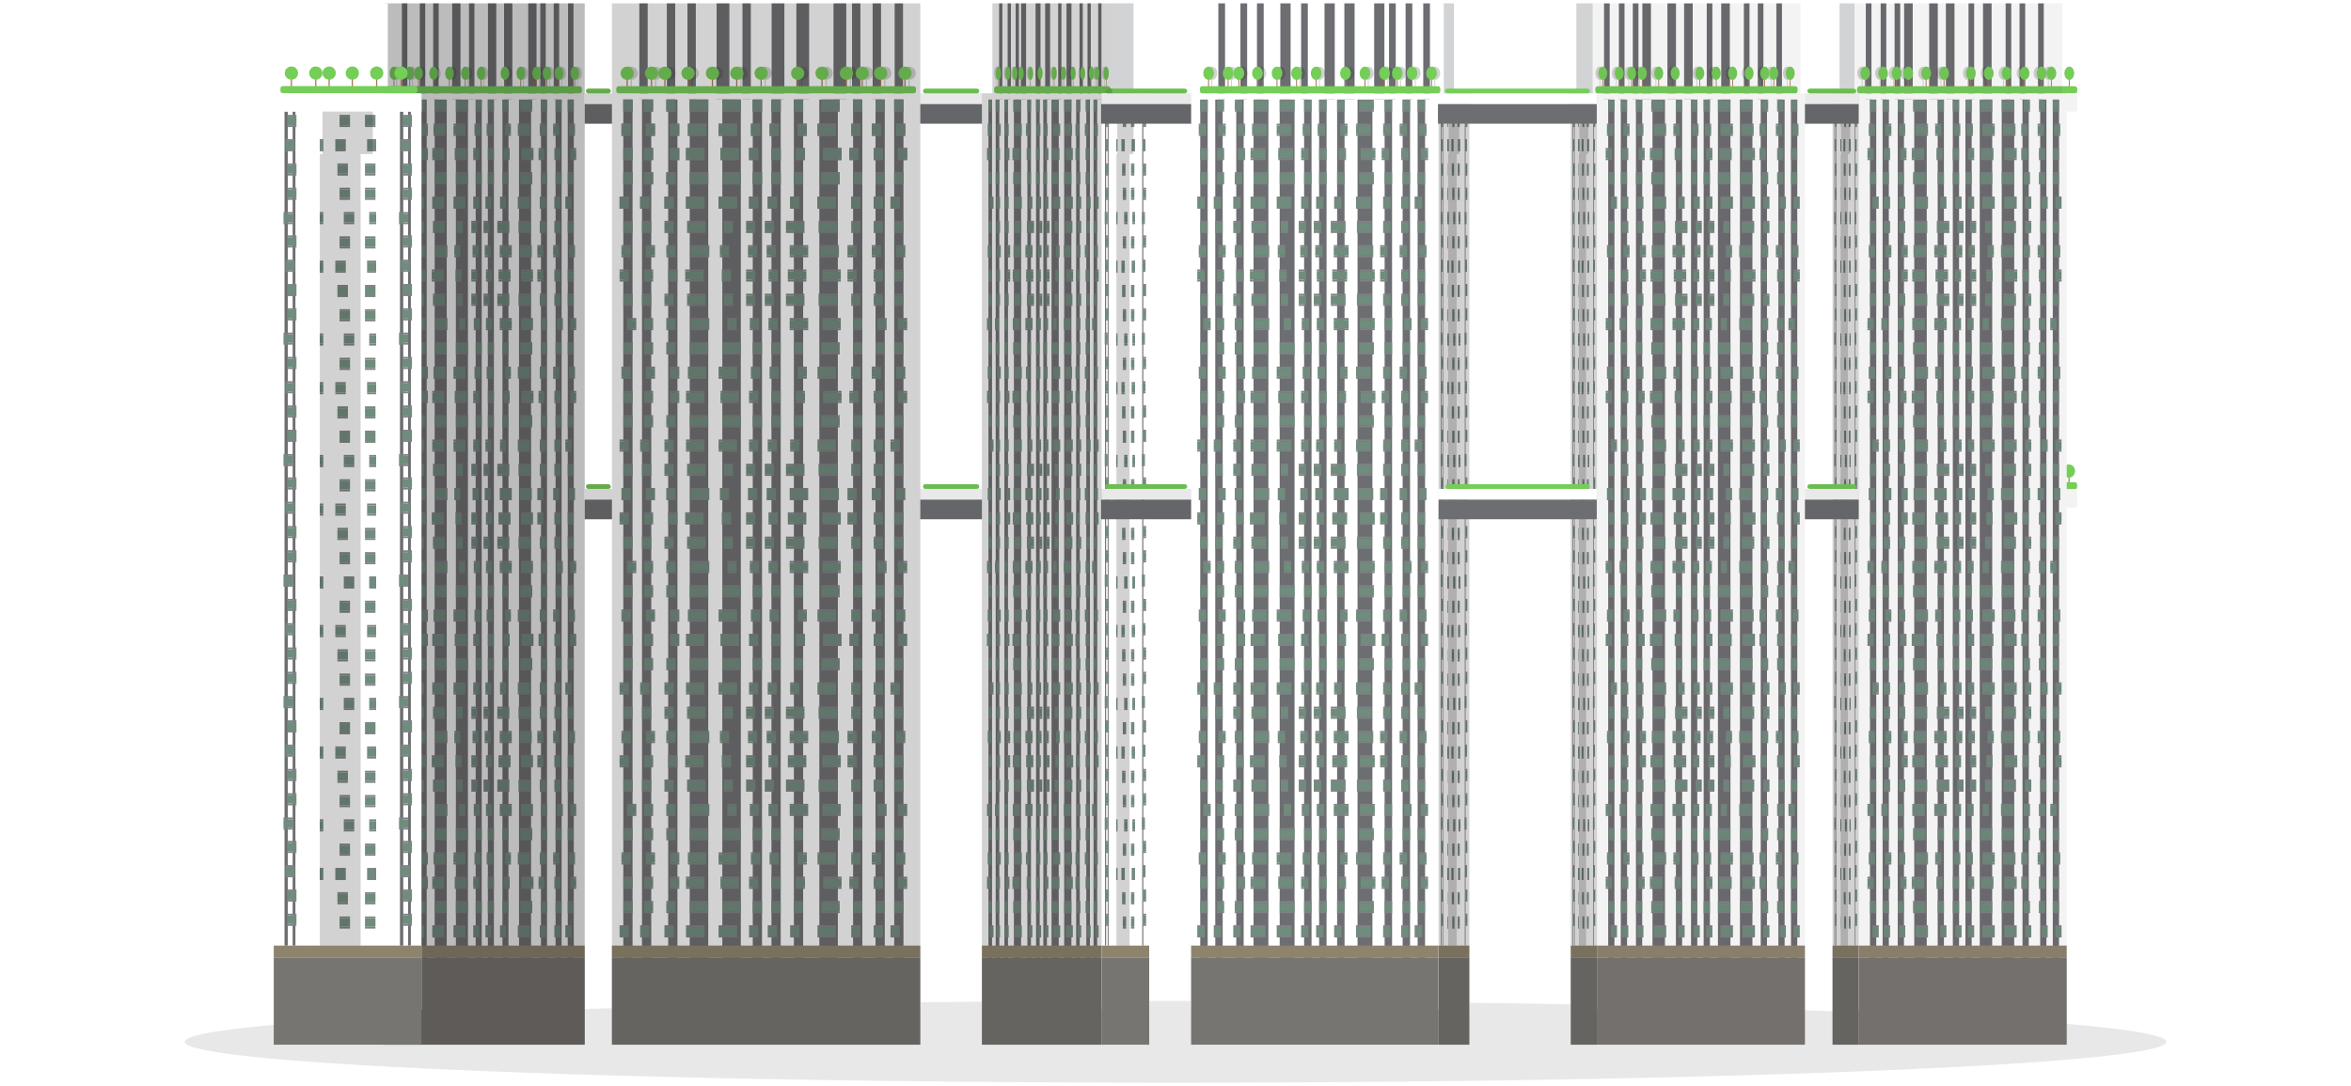
DATA PREPROCESSING
PAGE 06

Slide 7

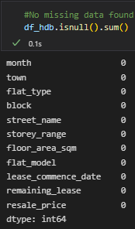

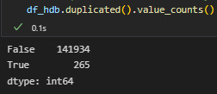

DATA PREPROCESSING - CHECKING FOR MISSING & DUPLICATE DATA
Checking the number of duplicated values
Checking the number of missing values
By using duplicated() and value counts() function, we can see that there are 265 duplicated records found. However, we can ignore this as it does not affect the dataset. We can make the assumption that the units on the same floor were sold the same price.
By using isnull() function, we can see that there are no missing values for all 11 columns.
PAGE 07

Slide 8
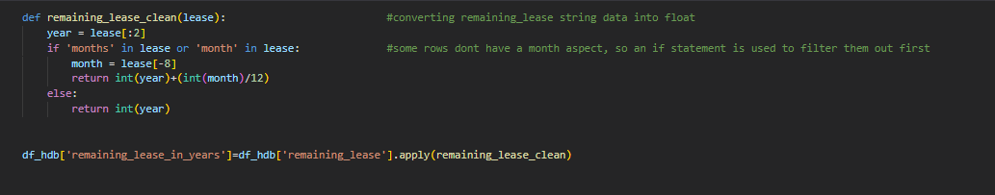
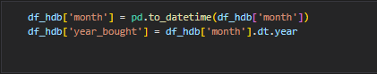

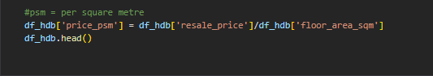
DATA PREPROCESSING - CONVERSION & FEATURE ENGINEERING
Converting column - "remaining_lease"
Converting column - "month"
As column "remaining_lease" is in object, we need to change it to int64 and create a new column called "remaining_lease_in_years"
Column "month"' datatype is in object64, we need to change it to int64 and create a new column called "year_bought"
Feature Engineering - Price per square metres (PSM)
As we will need price per square metres for our research. We need to create a new column by using resale_price/floor_area_sqm.
PAGE 08

Slide 9
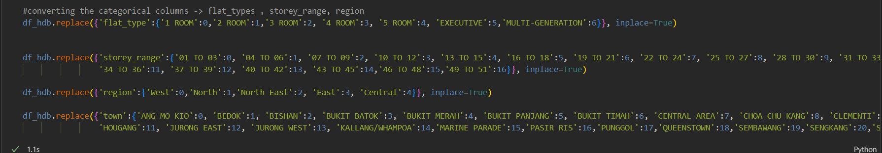
DATA PREPROCESSING – CATEGORICAL ENCODING
Categorical Encoding
Columns such as
“flat_types”, “storey_range”, “region” & “town” are in string datatype. Thus we will need to encode it before machine learning.
PAGE 09

Slide 10
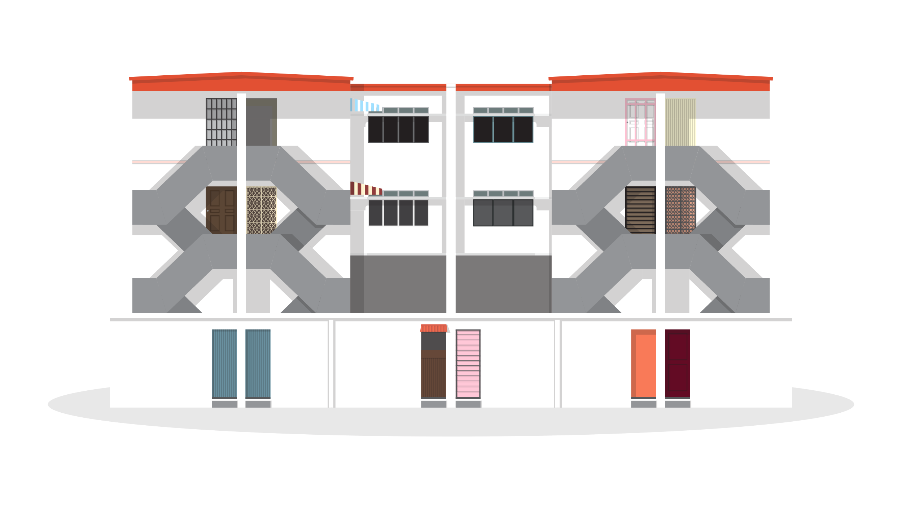
EXPLORATORY DATA ANALYSIS
PAGE 10

Slide 11
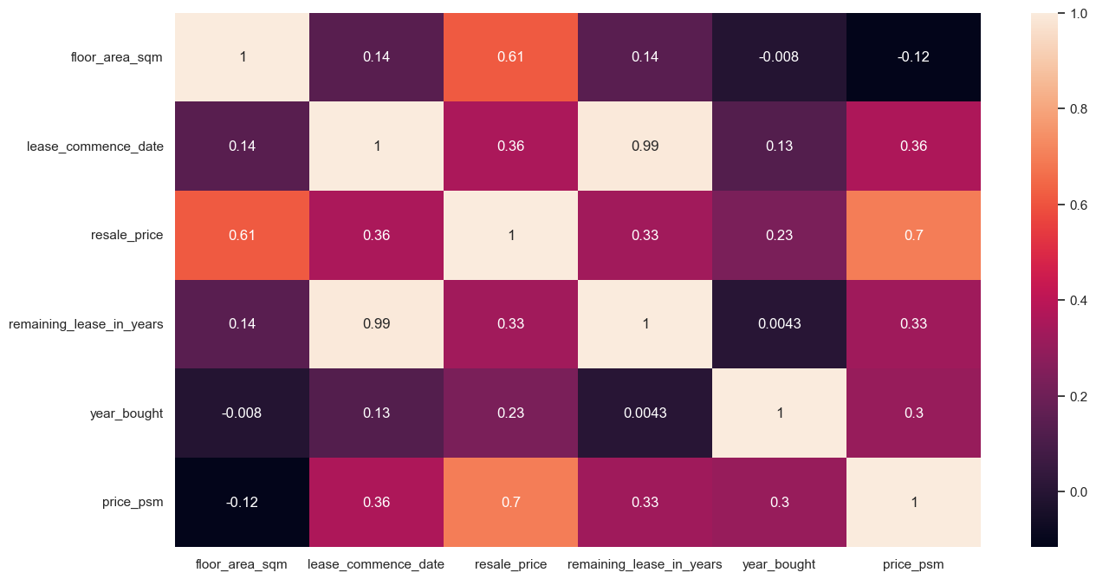
EDA - CORRELATION HEATMAP
Lease Commence Date & Remaining Lease in Years are highly correlated with each other
Other than that, there seems to be no strong correlation among independent features.
Resale price & price_psm are the labels.
Floor area seems to be more highly correlated to resale price, yet there does not seem to be any correlation with price per square metre.
PAGE 11

Slide 12
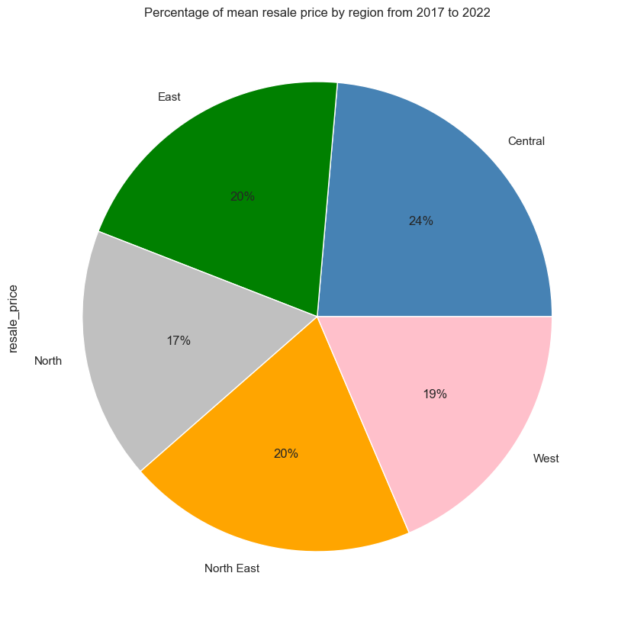
EDA - PERCENTAGE OF MEAN RESALE PRICE BY REGION FROM 2017 TO 2022
West Region Towns | North Region Towns | East Region Towns | Central Area Towns | North East Region Towns
Bukit Batok Bukit Panjang Choa Chu Kang Jurong East Jurong West Clementi | Sembawang Woodlands Yishun | Bedok Pasir Ris Tampines | Bishan Bukit Merah Bukit Timah Central Area Geylang Kallang/Whampoa Marine Parade Toa Payoh Queenstown | Ang Mo Kio Punggol Sengkang Serangoon Hougang
Distribution of resale flats transacted seems to be quite evenly distributed among the different regions of Singapore.
PAGE 12

Slide 13
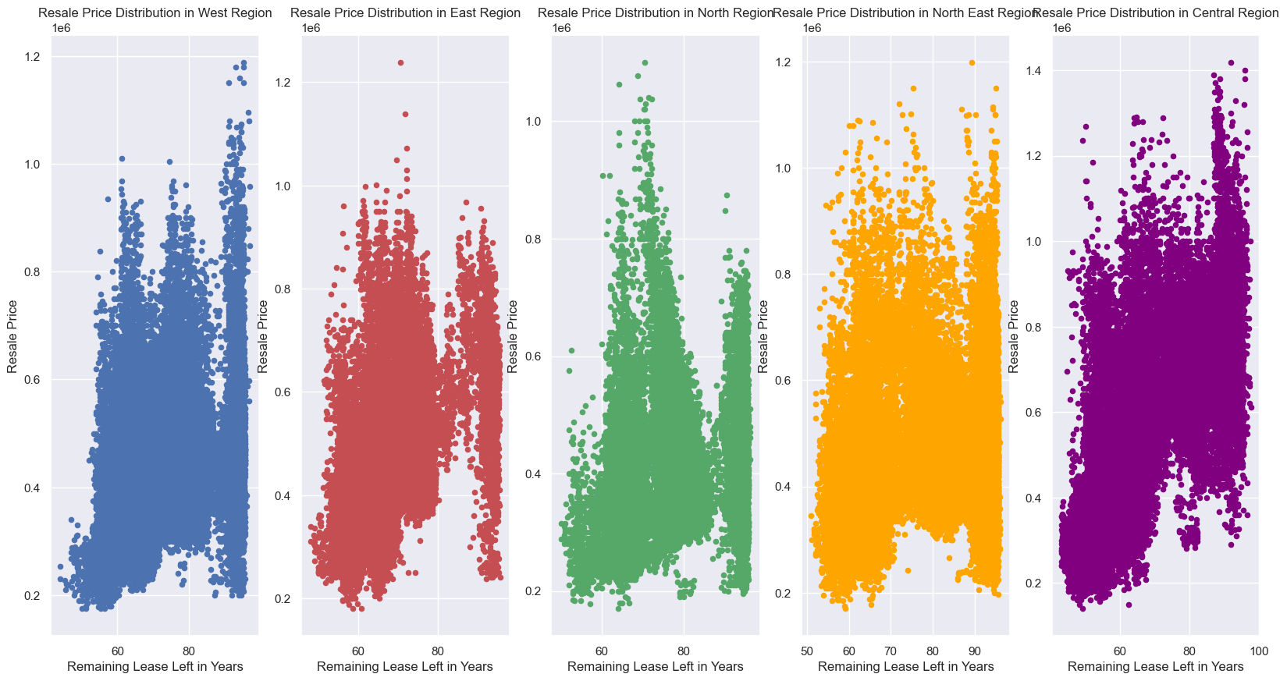
EDA - RESALE PRICE DISTRIBUTION BY REGION WRT TO REMAINING LEASE
In general, it seems that newer flats does not necessarily cost more.
In North Region, flats which are around 30-35 years old cost the highest.
In other regions of Singapore, newer flats' prices seem to be roughly the same as older flats other than West and Central, where newer flats seem to be more expensive.
PAGE 13

Slide 14
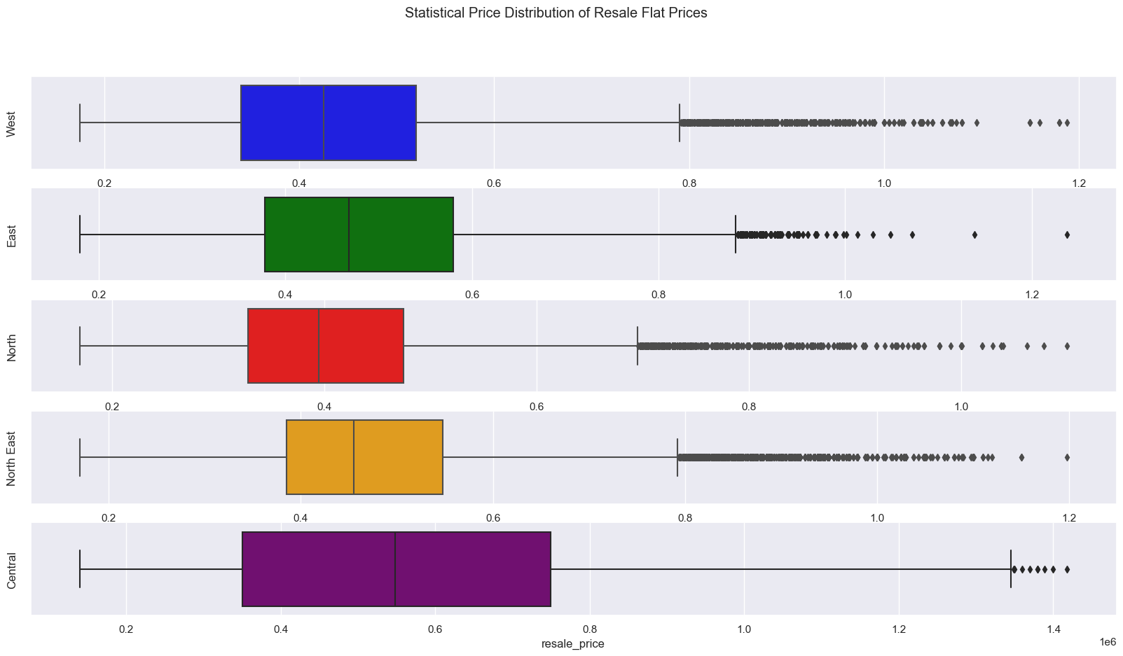
EDA - STATISTICAL PRICE DISTRIBUTION OF RESALE FLATS
The median price of resale flats in the Central area is the highest, which is to be expected.
There seems to be quite a number of outliers in all regions except Central area.
PAGE 14

Slide 15
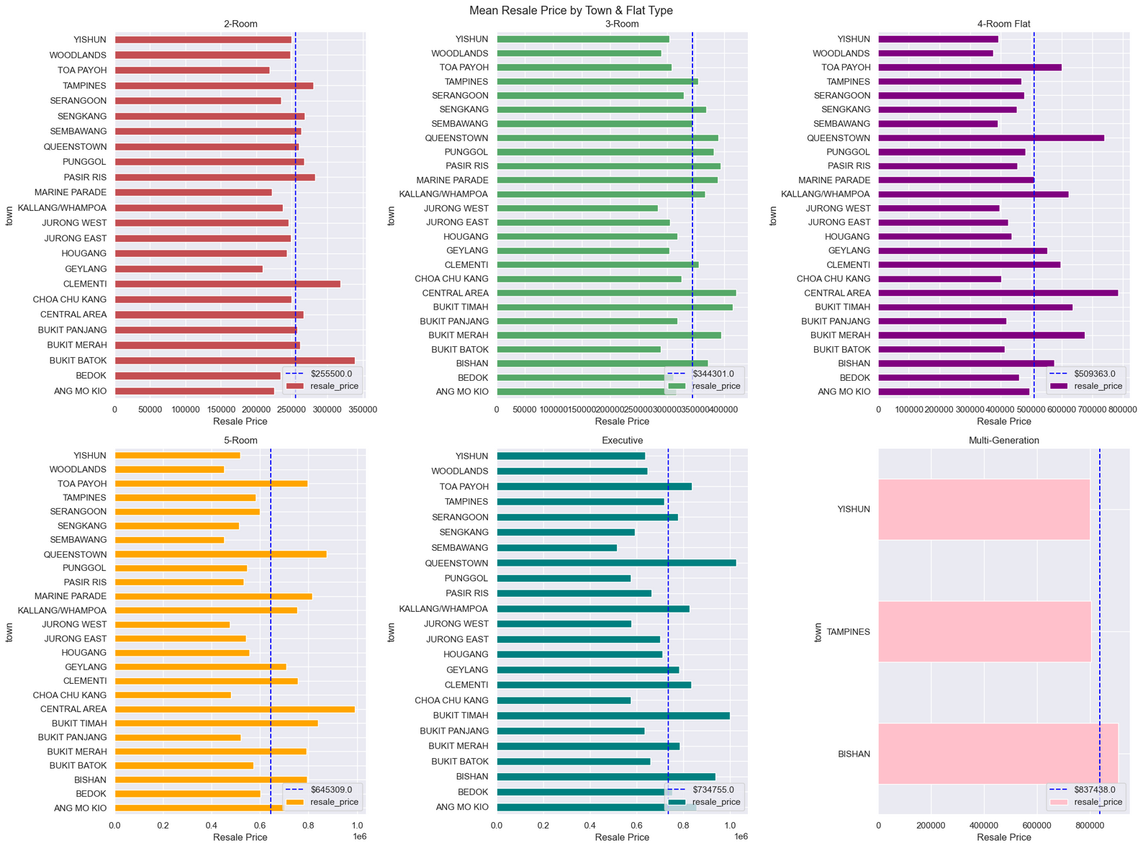
EDA - MEAN RESALE PRICE BY TOWN & FLAT TYPE
Average Price of Different Flat Sizes
1-room flat (no plot): ~$193k
2-room flat: ~$255k
3-room flat: ~$344k
4-room flat: ~$509k
5-room flat: ~$645k
Executive flats: ~$734k
Multigeneration flats: ~$837k
PAGE 15

Slide 16
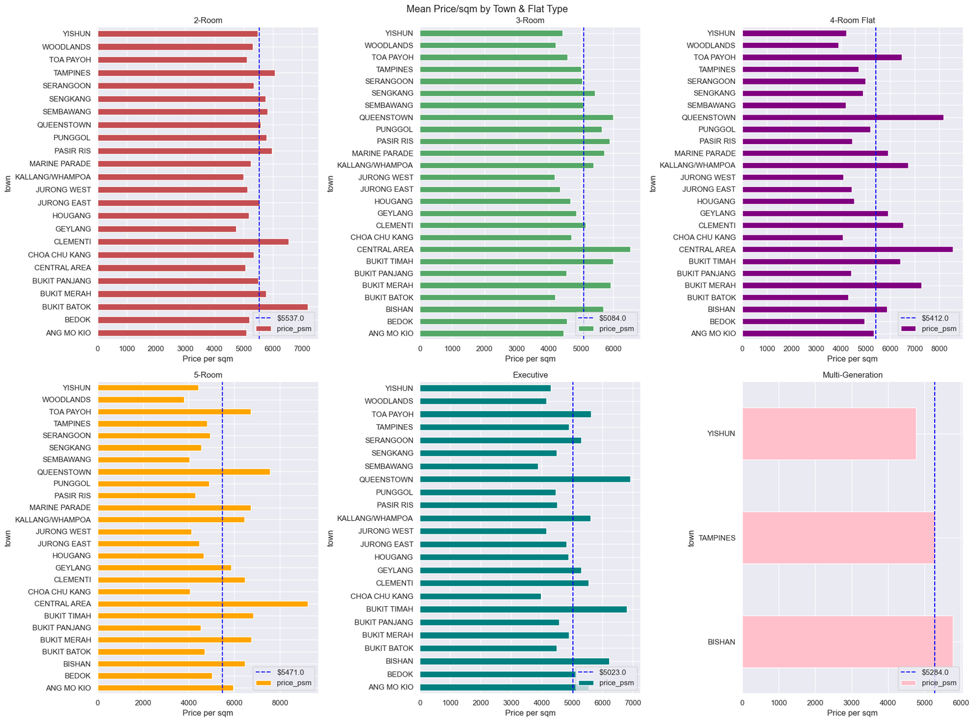
EDA - MEAN PRICE/SQM BY TOWN & FLAT TYPE
Average price/sqm by Flat Size
1-room flat (no plot): ~$6275/sqm
2-room flat: ~$5537/sqm
3-room flat: ~$5084/sqm
4-room flat: ~$5412/sqm
5-room flat: ~$5471/sqm
Executive flats: ~$5023/sqm
Multigeneration flats: ~$5284/sqm
3 room flats hold the lowest price/sqm while 1 room flats hold the highest price/sqm
PAGE 16

Slide 17
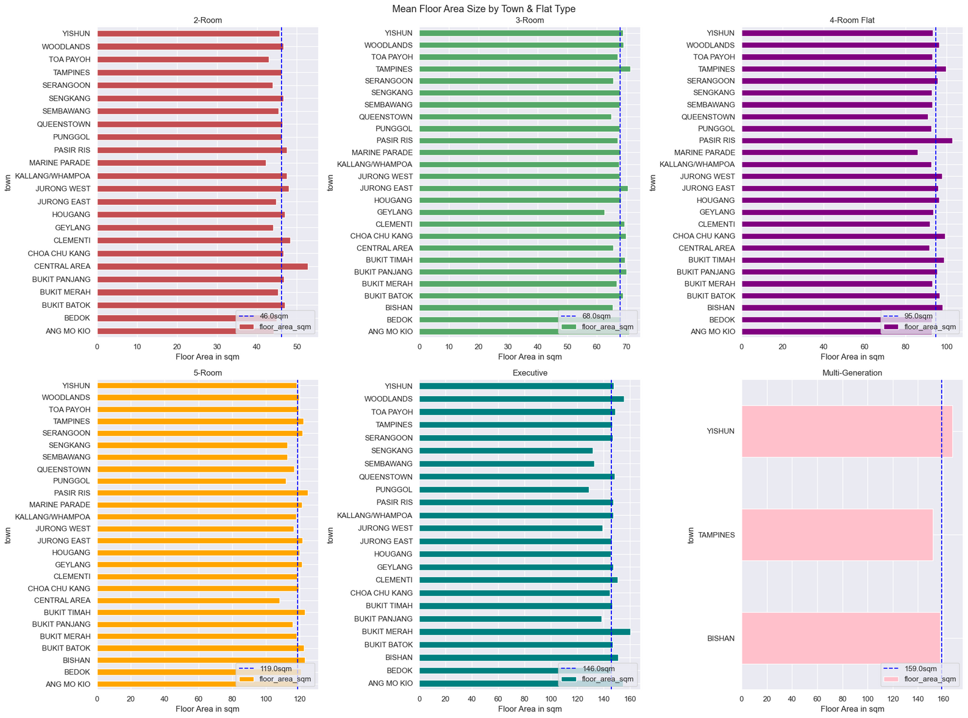
EDA - MEAN FLOOR AREA SIZE BY TOWN & FLAT TYPE
1 Room (no plot): Only Bukit Merah has 1 room flats & all flat sizes are the same.
2 Room: Central Area largest, Marine Parade smallest
3 Room: Tampines largest, Geylang smallest
4 Room: Pasir Ris largest, Marine Parade smallest
5 Room: Pasir Ris largest, Central Area smallest
Executive: Bukit Merah Largest, Punggol smallest
Multigeneration: Yishun largest, Tampines smallest
PAGE 17

Slide 18
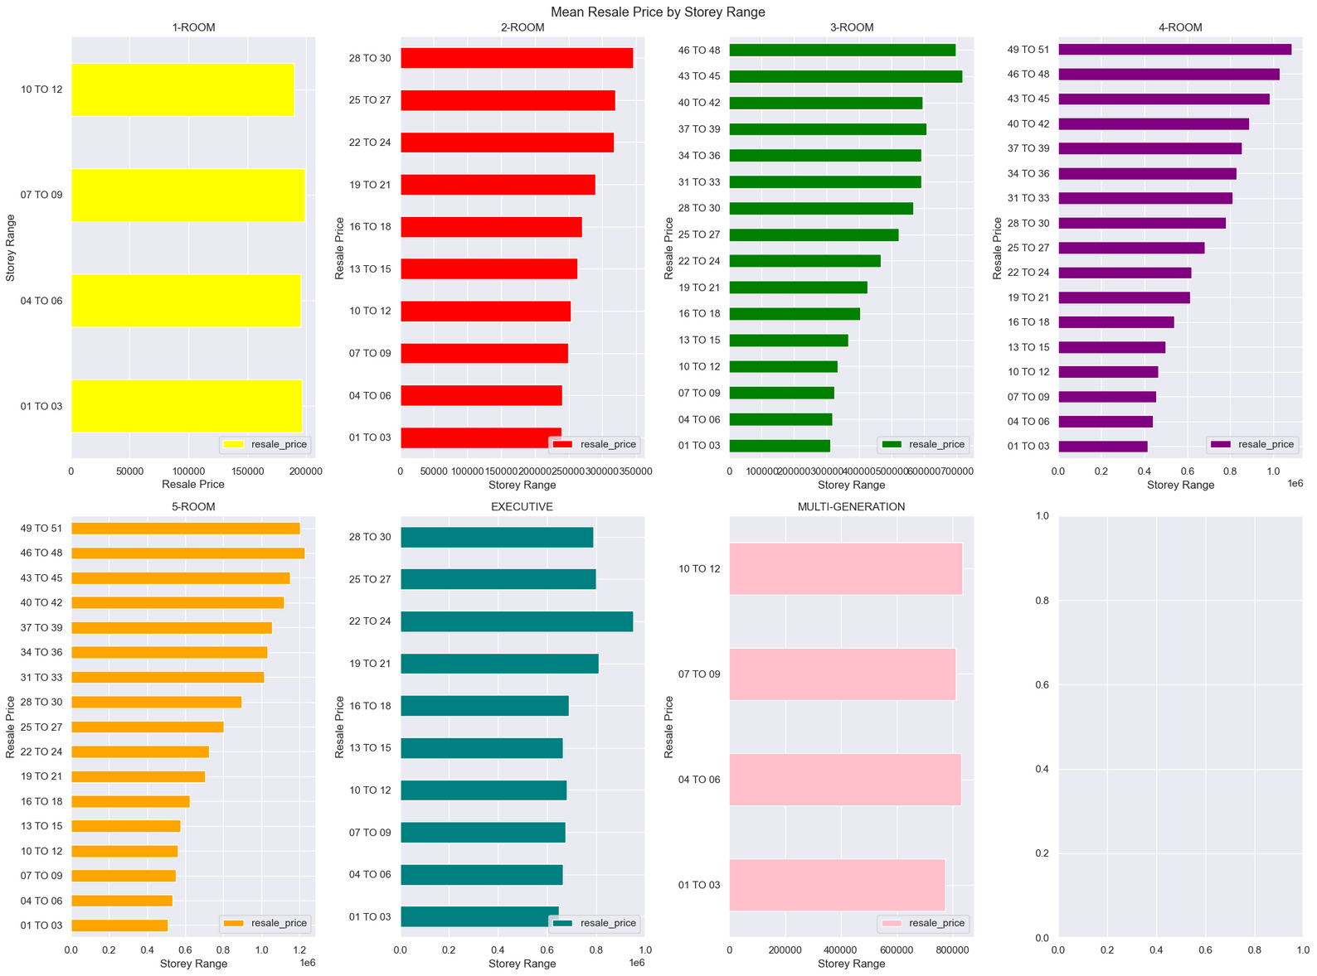
EDA - MEAN RESALE PRICE BY STOREY RANGE
Generally the higher the flat is located, the more expensive the flat.
PAGE 18

Slide 19
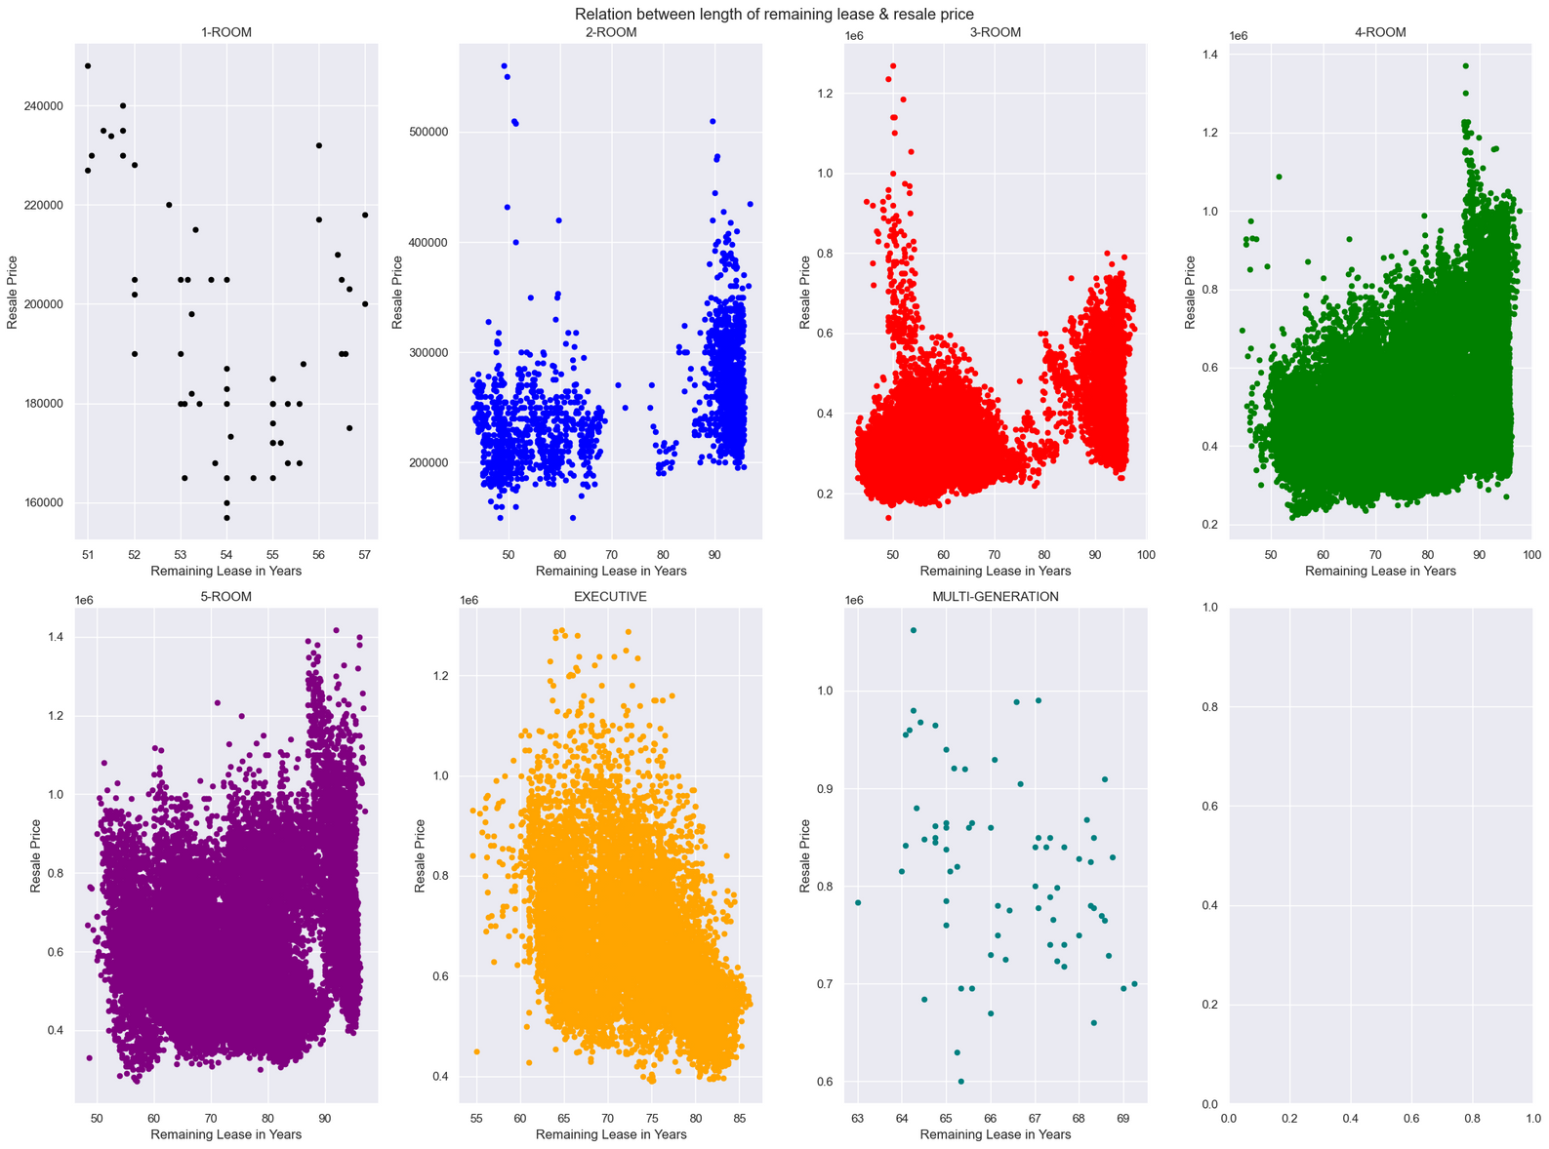
EDA - RELATION BETWEEN LENGTH OF REMAINING LEASE & RESALE PRICE
For 2-room,4-room and 5-room flats, newer flats are being transacted at higher prices than older flats on average
3-room flats generally follow the trend above, however, there are a significant number of older flats being transacted at higher prices than newer ones
For Executive Flats, older flats are being transacted at higher prices than newer flats on average
For 1-Room and Multigeneration Flats, there seem to be no relation between age of flat and resale price.
PAGE 19

Slide 20
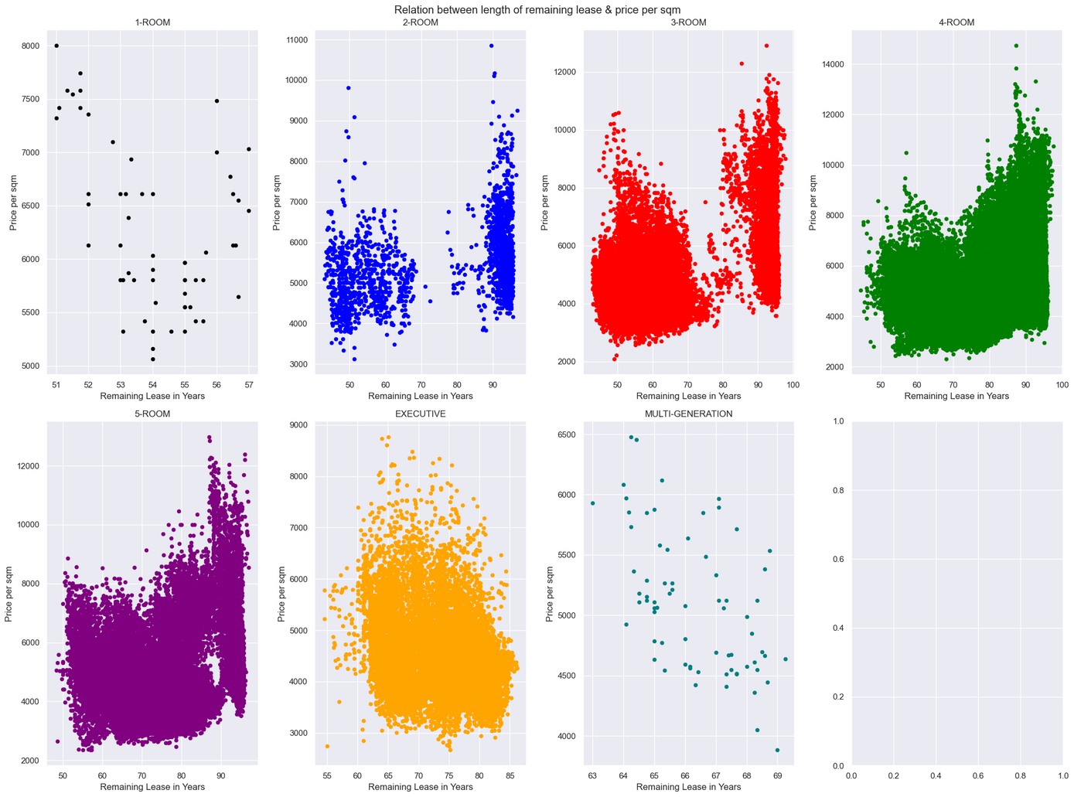
EDA - RELATION BETWEEN LENGTH OF REMAINING LEASE & PRICE PER SQM
Newer flats tend to have a higher price per sqm for all flats besides Executive, Multigeneration & 1 Room Flats.
For the 3 exceptions, older flats command a higher price per sqm.
PAGE 20

Slide 21
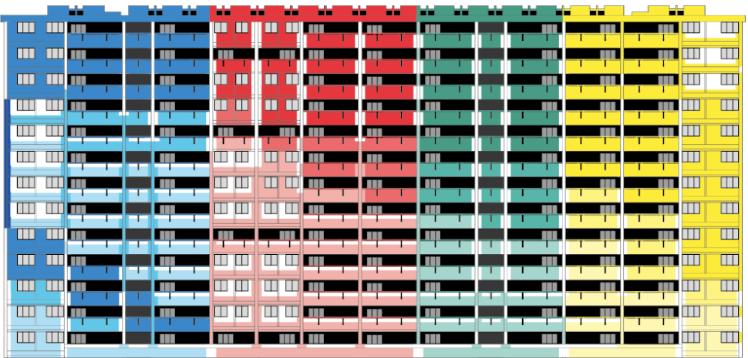
MACHINE LEARNING MODELS
PAGE 21

Slide 22
BEFORE WE START
Machine Learning Models Used:
Train Test Split Data:
Linear Regression Model
Lasso Regression Model
Ridge Regression Model
ElasticNet Model
Random Forest Model
Support Vector Regressor Model
Gradient Boosting
XGBoost
Train Data - 80%
Test Data - 20%
Features Used:
Metric Used:
Town
Flat Type
Storey Range
Floor Area in sqm
Remaining Lease in Years
RMSE
R2 Score
PAGE 22

Slide 23
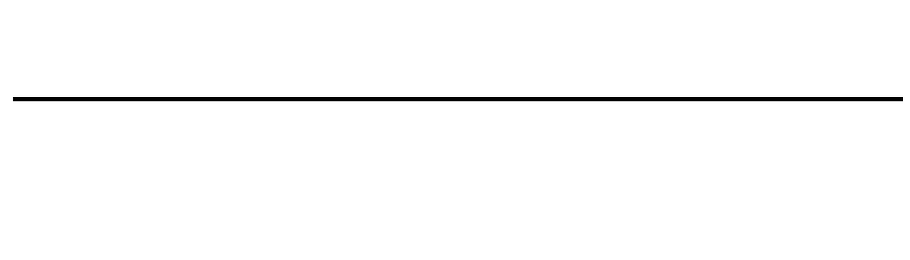
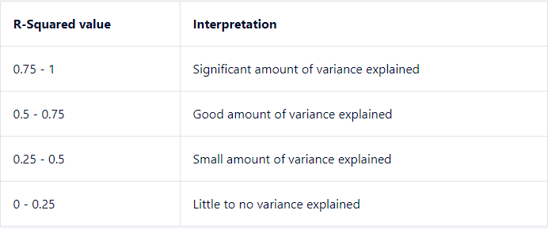
BEFORE WE START - CONSIDERATIONS FOR A GOOD METRIC
R2 Score:
RMSE (Root Mean Squared Error) :
What is a good R-Squared value?
R-Squared is a measure of fit where the value ranges from 1, where all variance is explained, to 0 where none of the variance is explained.
Is a higher R-squared value good?
The higher the R-Squared value is the better. Higher values imply that more of the variation in the dependent variable is explained by the independent variables in the regression model.
Should RMSE be high or low?
RMSE is a metric which ranges from 0 to infinity, where the closer the score is to 0 the better performing the model is. Therefore, the RMSE value should be as low as possible.
What is a good RMSE value?
The closer RMSE is to 0, the more accurate the model is.
PAGE 23

Slide 24
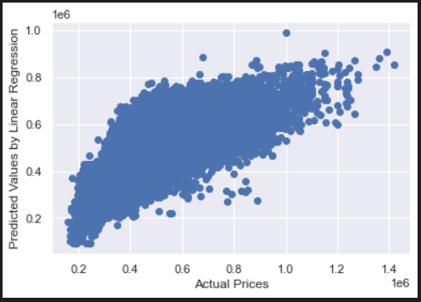
LINEAR REGRESSION MODEL
Resale Price
Price per Sqm
RMSE: 109,925
% error from mean: 23.1%
R2 Score: 0.555
RMSE: 1109
Percentage error from mean: 22.59%
R2 Score: 0.3167
Simple Linear Regression used as base model to set the threshold for other models to improve upon
RMSE percentage error for both labels are quite high
R2 score for price per sqm is quite low.
PAGE 24

Slide 25
LASSO REGRESSION MODEL
Resale Price (alpha = 0.8)
Price per Sqm (alpha = 0.8)
RMSE: 109,925
% error from mean: 23.1%
R2 Score: 0.555
RMSE: 1109
Percentage error from mean: 22.59%
R2 Score: 0.3167
A random bunch of alpha values ranging from 0.2-5 were tested with no meaningful improvement in result.
Alpha value of 0.8 is just a random value
PAGE 25

Slide 26
RIDGE REGRESSION MODEL
Resale Price (alpha = 0.3)
Price per Sqm (alpha = 0.8)
RMSE: 109,925
% error from mean: 23.1%
R2 Score: 0.555
RMSE: 1109
Percentage error from mean: 22.59%
R2 Score: 0.3167
Similarly to Lasso Regression , varying alpha values did not yield any significant change in evaluation results.
Alpha values here are just random values
PAGE 26

Slide 27
ELASTICNET MODEL
Resale Price (alpha = 0.3, L1 = 0.8)
Price per Sqm (alpha = 0.2, L1 = 0.9)
RMSE: 109,991
% error from mean: 23.12%
R2 Score: 0.5545
RMSE: 1109
Percentage error from mean: 22.59%
R2 Score: 0.3166
It was found that generally, a low alpha value and a high L1 value yielded better evaluation results.
ElasticNet model performed slightly worse than base Linear Regression.
Alpha & L1 values selected are ones which yield lowest error and highest R2 score.
PAGE 27

Slide 28
RANDOM FOREST REGRESSOR BASE MODEL
Resale Price
Price per Sqm
RMSE: 99,485
% error from mean: 20.91%
R2 Score: 0.6356
RMSE: 908
Percentage error from mean: 18.51%
R2 Score: 0.5414
RandomForestRegressor was used as this is a regression problem.
Base RF models were trained and tested using random hyperparameter values (n_estimators, max_depth, max_features etc.)
Slight improvement over Linear Regression Model.
PAGE 28

Slide 29
RANDOM FOREST MODEL - HYPERPARAMETER TUNING
Resale Price
Price per Sqm
RMSE: 84,562
% error from mean: 17.77%
R2 Score: 0.7367
RMSE: 793
Percentage error from mean: 16.16%
R2 Score: 0.6501
Dictionary of hyperparameter values was created.
RandomizedSearchCV was used to search for the best possible values from the dictionary.
5 fold cross validation was built into the model.
Significant improvement in evaluation metrics for resale price prediction.
PAGE 29

Slide 30
RANDOM FOREST MODEL 2 - TRYING OUT DIFFERENT HYPERPARAMETERS
Resale Price
Price per Sqm
RMSE: 79,386
% error from mean: 16.69%
R2 Score: 0.7679
RMSE: 786
Percentage error from mean: 16.02%
R2 Score: 0.6562
Another dictionary with different hyperparameter values was created.
Slight improvement in evaluation metrics for both labels over the first tuned Random Forest model
PAGE 30

Slide 31
SUPPORT VECTOR REGRESSOR MODEL
Resale Price
Price per Sqm
RMSE: 116,628
% error from mean: 24.51%
R2 Score: 0.4992
RMSE: 1137
Percentage error from mean: 23.16%
R2 Score: 0.2818
LinearSVR was used as dataset is large
Support Vector Regressor Model performed worse than Linear Regression Model.
SVM as a whole are not suited to large datasets
PAGE 31

Slide 32
GRADIENT BOOSTING MODEL
Resale Price
Price per Sqm
RMSE: 52,434
% error from mean: 11.02%
R2 Score: 0.8988
RMSE: 501
Percentage error from mean: 10.21%
R2 Score: 0.8604
Similar to the tuned RF model, RandomizedSearchCV was used on a dictionary of hyperparameters (n_estimators, learning rate, max_depth) to search for the best possible combination.
5 fold cross validation built in.
More improvement over both tuned RF models
PAGE 32

Slide 33
GRADIENT BOOSTING MODEL 2- TRYING OUT DIFFERENT HYPERPARAMETERS
Resale Price
Price per Sqm
RMSE: 52,434
% error from mean: 11.02%
R2 Score: 0.8988
RMSE: 486
Percentage error from mean: 9.92%
R2 Score: 0.8684
Repeating the process with a different set of hyperparameters yielded no improvement for resale price but there was a slight improvement in evaluation results for price per sqm prediction.
Perhaps we can improve on price per sqm prediction more...
PAGE 33

Slide 34
GRADIENT BOOSTING MODEL 3 - TRYING OUT DIFFERENT HYPERPARAMETERS
Price per Sqm
RMSE: 488
Percentage error from mean: 9.95%
R2 Score: 0.8674
Gradient Boosting repeated for price per sqm prediction with slightly less favourable results
Best performing GB model so far is GB2.
PAGE 34

Slide 35
XGBOOST
Resale Price
Price per Sqm
RMSE: 51,747
% error from mean: 10.87%
R2 Score: 0.9014
RMSE: 523
Percentage error from mean: 10.66%
R2 Score: 0.8479
XGBoost seems to lose out very slightly over the Gradient Boosting models for price per sqm whereas it outperforms for resale price prediction.
However, XGBoost achieved these results in seconds while GB takes at least a few minutes to train; longer for larger datasets
PAGE 35

Slide 36
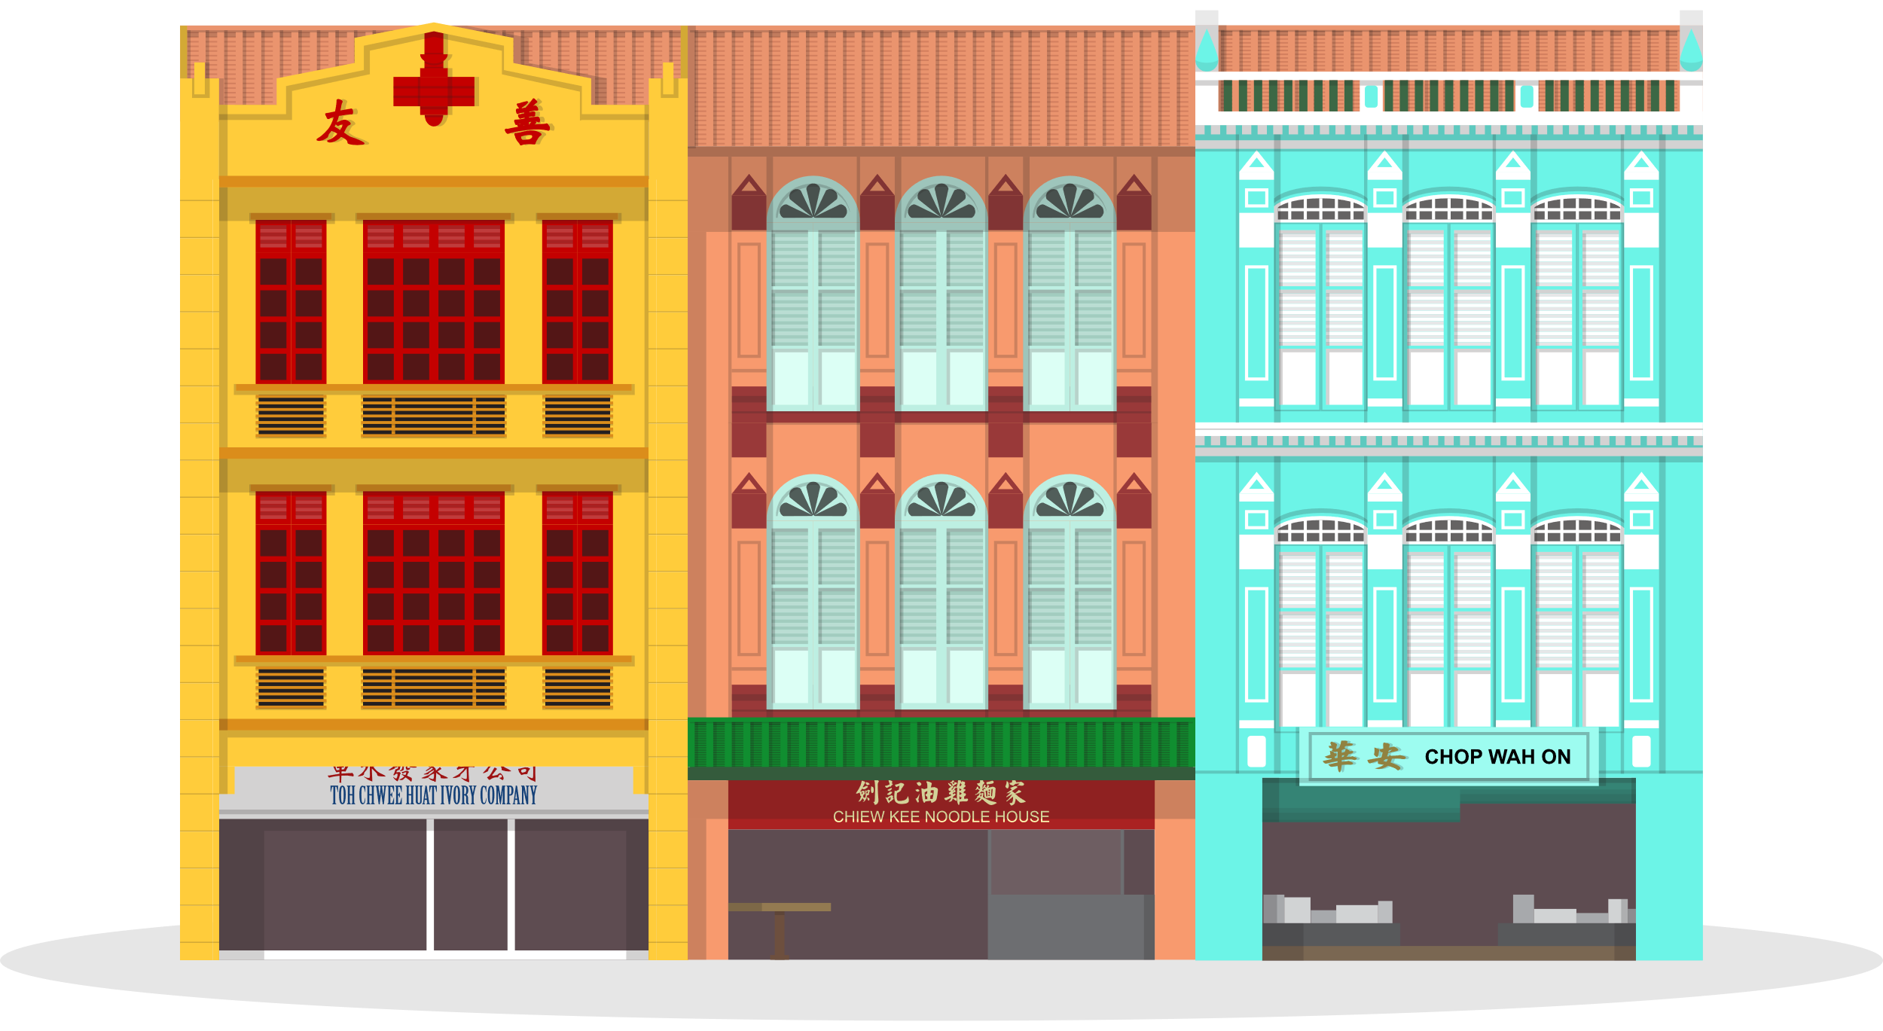
MODEL COMPARISON
PAGE 36

Slide 37
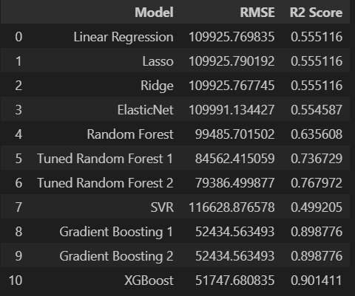
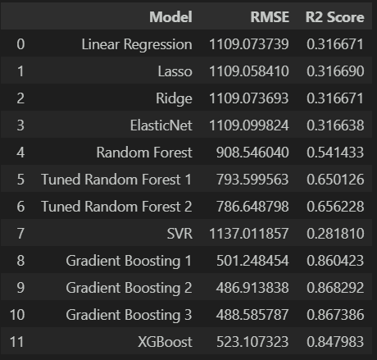
MODEL COMPARISON
Resale Price
Price Per Sqm
XGBoost is the best performing model for this label
GB2 is the best performing model for this label
PAGE 37

Slide 38
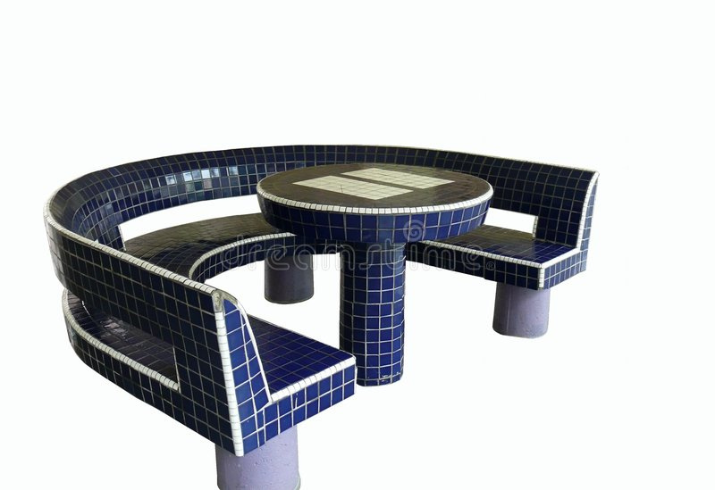
HDB PRICE PREDICTOR
PAGE 38

Slide 39
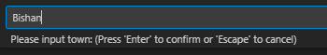

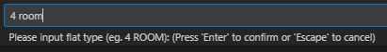
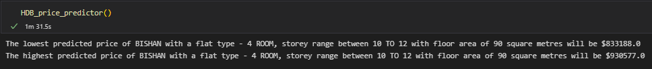
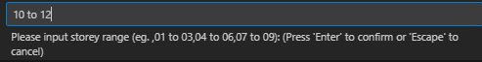


HDB PRICE PREDICTOR (RESALE PRICE & PSM)
User enters desired town
Final Result
PSM
User enters desired flat type
Resale Price
User enters desired storey range
The final result is presented as a range between the lowest and the highest predicted prices based, taking into account model RMSE.
Inflation rate was also taken into account in the final prediction.
User enters desired floor per sqm
PAGE 39

Slide 40

CHALLENGES
PAGE 40

Slide 41

CHALLENGES FACED AS A TEAM
There were many different sources with different perceptions of the region which the towns belong to. For eg. Bishan
Limited data for certain flat type which may not give the best accurate price for those flat types. For eg. 1 Room
More complex models such as Random Forest & Gradient Boosting take some time to train on large dataset; limits the extent with which we can re-run and fine tune the models.
We are unable to find out the true value of inflation in the next 5 years. Therefore, we took the average inflation rate * 5. This may decrease the accuracy of the predictor.
Due to time constraint, the team is unable to further improve the metric score to make it more accurate.
User input is not restricted, so users can input conflicting information which will impact the predictability of the label (e.g. user can input flat type as 4 room and floor area size as 40sqm, which is the size of a 2 room flat)
PAGE 41

Slide 42

CONCLUSION
For Resale Price
XGBoost has the best prediction with a relatively low RMSE. Gradient Boosting 2 came in second while SVR comes in last.
For PSM
Gradient Boosting 2 has the best prediction with relatively low RMSE. Gradient Boosting 3 came in second while SVR comes in last.
We can definitely improve the models, perhaps by obtaining more data such as the number of times the flat was transacted or even the distance from closest MRT station. Ultimately, with more relevant information the better the metric score and prediction models.
To add on, by inputting this model into a website, it will improve the interface and user's experience making it more pleasant for usage and aesthetically beautiful.
PAGE 42

Slide 43
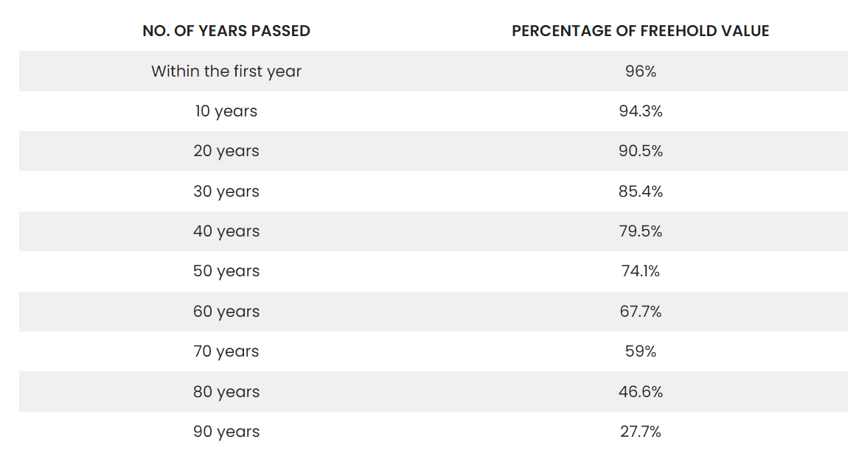
CONCLUSION-A TOP TIP
Contrary to what some people might believe, properties generally start to depreciate as soon as their leases start.
On average, flats which are 20 years old retain their value well, up to 90.5%!
Past that, the rate of depreciation increases with flats losing ~5% of their value every 10 years up till 50 years old.
Past 50 years old, flats lose value at a rapid rate.
Our advice?
Best to let go of a new BTO flat within the first 20 years if intending to do so.
Image Credit: Justin Kong, how-long-should-you-hold-on-to-a-99-year-lease-property-or-flat
PAGE 43

Slide 44
SOURCES
https://stephenallwright.com/good-rmse-value/
https://www.analyticsvidhya.com/blog/2021/05/know-the-best-evaluation-metrics-for-your-regression-model/
https://data.gov.sg/dataset/resale-flat-prices
https://www.bmc.com/blogs/mean-squared-error-r2-and-variance-in-regression-analysis/
https://www.mas.gov.sg/news/monetary-policy-statements/2022/mas-monetary-policy-statement-14oct22#:~:text=For%202022%20as%20a%20whole,inflation%20at%205.5%E2%80%936.5%25.
https://www.teoyusiang.com/buildingsingapore/
https://aspiringpropertyinvestors.com/how-long-should-you-hold-on-to-a-99-year-lease-property-or-flat/
PAGE 44

Slide 45
Thank You Very Much
For Your Attention!
PAGE 45

